Slide 1

DYNAMIC AFM
-1- Amplitude Modulation Mode (or tapping mode) AM-AFM
THIS IS WHAT WE HAVE STUDIED IN THE QBIO COURSE
Constant Amplitude (feedback loop)
Intermittent mechanical contact between tip and sample
Tip position (z) described by non-linear harmonic oscillator → no analytical solutions, but numerical, often multiple, solutions exist
$$mz+δz+kz=Finteraction\left(z\right)+F0(ωt)$$
LUCA COSTA – QBio– Introduction to AFM – Supplementary - 1

Slide 2
DYNAMIC AFM
-1- Amplitude Modulation Mode (or tapping mode) AM-AFM
THIS IS WHAT WE HAVE STUDIED IN THE QBIO COURSE
Constant Amplitude (feedback loop)
Intermittent mechanical contact between tip and sample
Tip position (z) described by non-linear harmonic oscillator → no analytical solutions, but numerical, often multiple, solutions exist
$$mz+δz+kz=Finteraction\left(z\right)+F0(ωt)$$
-2- Frequency Modulation Mode – FM-AFM
WE DID NOT MENTION THIS ONE IN THE QBIO COURSE
T. R. Albrecht, P. Gritter, F. Horne, D. Rugar, “Frequency modulation detection using high-q cantilevers for enhanced force microscope sensitivity”, J. Appl. Phys, vol. 69, pp. 668-673, 1991
LUCA COSTA – QBio– Introduction to AFM – Supplementary - 2

Slide 3
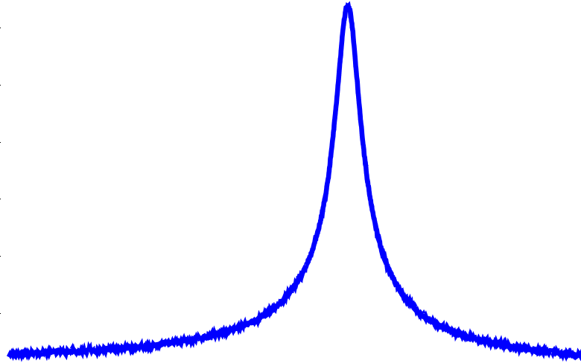



FREQUENCY MODULATION MODE
If amplitude of tip oscillation: 0.1nm – 1nm (ten times lower than in AM-AFM),
Because of $Finteraction\left(z\right),$the resonance frequeny$ω_{R}$shifts to a new frequency ${ω^{′}}_{R}$
Amplitude
F.J. Giessibl, Advances in atomic force microscopy, Rev. Mod. Physics, 75(3), 2003
$${ω^{′}}_{R}$$
$$ω_{R}$$
$$ω$$
LUCA COSTA – QBio– Introduction to AFM – Supplementary - 3

Slide 4
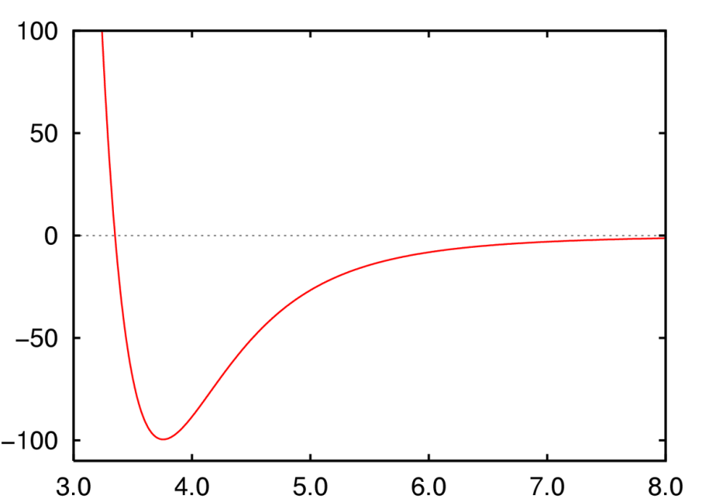
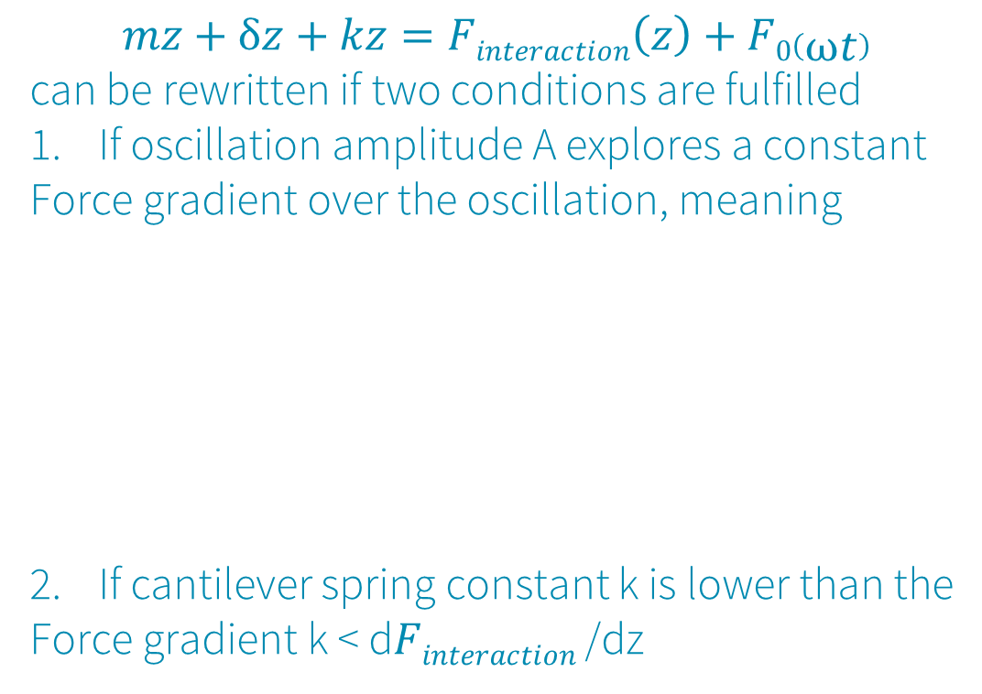
FREQUENCY MODULATION MODE
If amplitude of tip oscillation: 0.1nm – 1nm (ten times lower than in AM-AFM),
Because of $Finteraction\left(z\right),$the resonance frequeny$ω_{R}$shifts to a new frequency ${ω^{′}}_{R}$
$$mz+δz+kz=Finteraction\left(z\right)+F0\left(ωt\right)$$
can be rewritten if two conditions are fulfilled
If oscillation amplitude A explores a constant
Force gradient over the oscillation, meaning
If cantilever spring constant k is lower than the
Force gradient k < d$Finteraction$/dz
Amplitude
F.J. Giessibl, Advances in atomic force microscopy, Rev. Mod. Physics, 75(3), 2003
Frequency modulation
As in tapping mode
A
A
$${ω^{′}}_{R}$$
$$ω_{R}$$
And not
$$ω$$
Force gradient
(Force derivative)
changing over
Oscillation amplitude
LUCA COSTA – QBio– Introduction to AFM – Supplementary - 4

Slide 5
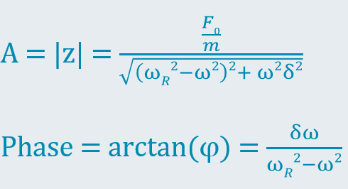
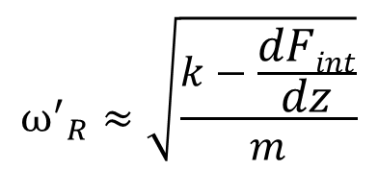

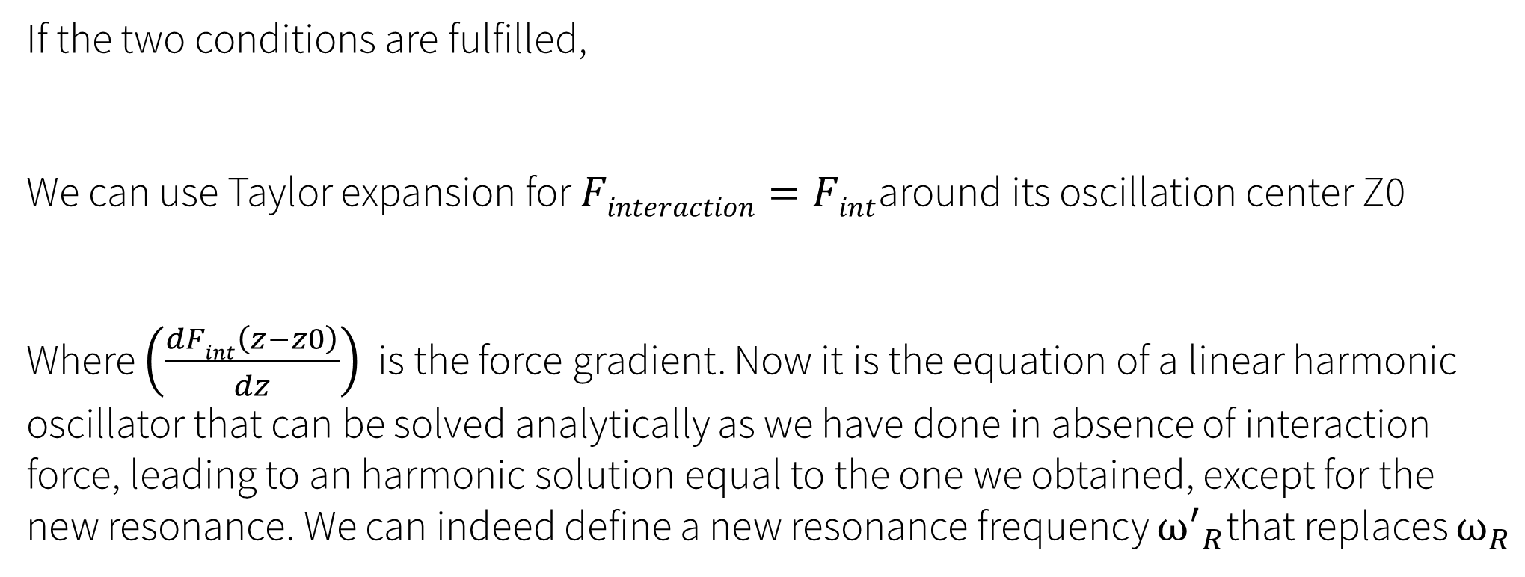
FREQUENCY MODULATION MODE
If the two conditions are fulfilled,
We can use Taylor expansion for $Finteraction=Fint$around its oscillation center Z0
Where $\left(\frac{dFint\left(z−z0\right)}{dz}\right)$ is the force gradient. Now it is the equation of a linear harmonic
oscillator that can be solved analytically as we have done in absence of interaction force, leading to an harmonic solution equal to the one we obtained, except for the new resonance. We can indeed define a new resonance frequency ${ω^{′}}_{R}$that replaces $ω_{R}$
$$mz+δz+kz=Finteraction\left(z\right)+F0(ωt)$$
$$mz+δz+kz=Fint\left(z−z0\right)+\left(\frac{dFint\left(z−z0\right)}{dz}\right)\left(z−z0\right)+…+F0(ωt)$$
$${ω^{′}}_{R}≈\sqrt{\frac{k−\frac{dFint}{dz}}{m}}$$
LUCA COSTA – QBio– Introduction to AFM – Supplementary - 5

Slide 6
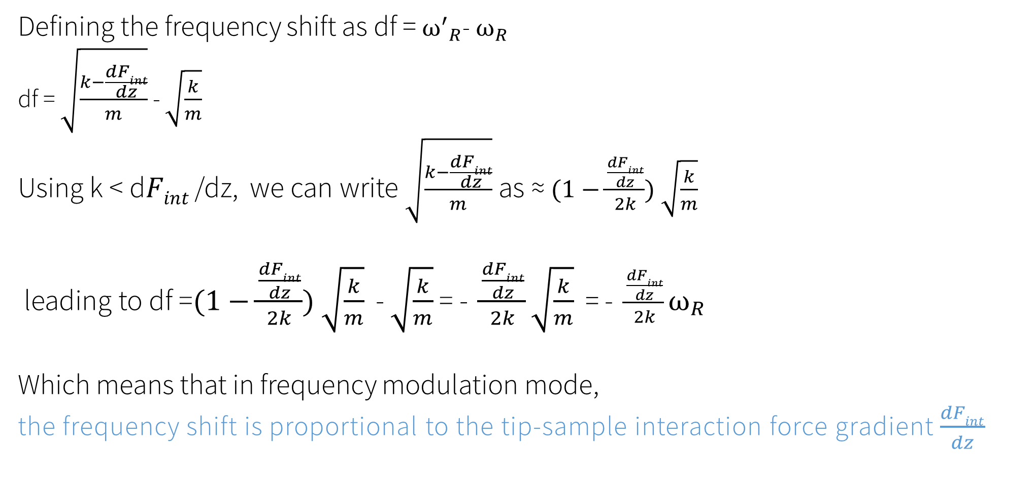
FREQUENCY MODULATION MODE
Defining the frequency shift as df = ${ω^{′}}_{R}$-$ω_{R}$
df = $\sqrt{\frac{k−\frac{dFint}{dz}}{m}}$ - $\sqrt{\frac{k}{m}}$
Using k < d$Fint$/dz, we can write $\sqrt{\frac{k−\frac{dFint}{dz}}{m}}$ as ≈ $(1−\frac{\frac{dFint}{dz}}{2k}) \sqrt{\frac{k}{m}}$
leading to df =$(1−\frac{\frac{dFint}{dz}}{2k}) \sqrt{\frac{k}{m}}$ - $\sqrt{\frac{k}{m}}$ = - $\frac{\frac{dFint}{dz}}{2k}\sqrt{\frac{k}{m}}$ = - $\frac{\frac{dFint}{dz}}{2k}ω_{R}$
Which means that in frequency modulation mode,
the frequency shift is proportional to the tip-sample interaction force gradient $\frac{dFint}{dz}$
LUCA COSTA – QBio– Introduction to AFM – Supplementary - 6

Slide 7
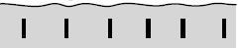
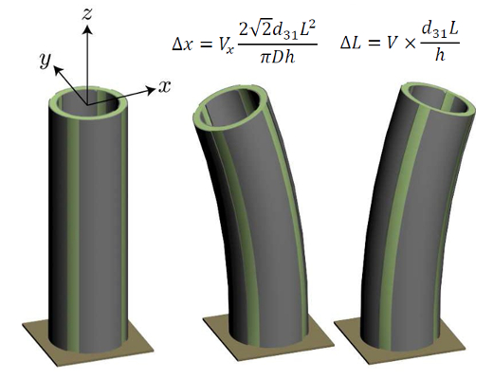

AFM operational scheme
Cantilever frequency shift
Optical
system
$$\text{A}$$
Cantilever
Sample
Magic box
X/Y/Z Scanner
LUCA COSTA – QBio– Introduction to AFM – Supplementary - 7

Slide 8
AFM operational scheme
Cantilever amplitude
Optical
system
Constant
Frequency shift
$$\text{A}$$
Cantilever
Sample
Magic box
X/Y/Z Scanner
LUCA COSTA – QBio– Introduction to AFM – Supplementary - 7

Slide 9
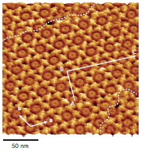
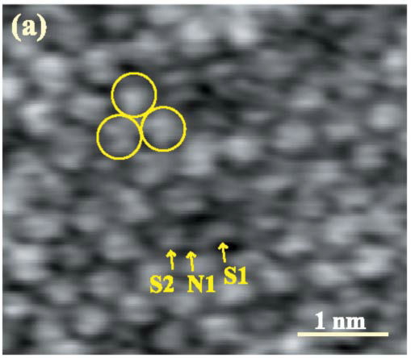
Frequency modulation mode
Mainly used for AFM in vacuum
High Q-factor is important
Bio (in liquid) application on FLAT samples
Hirofumi Yamada
Takeshi Fukuma
Antibody
crystal
S. Ido et al.
Nature Materials,
13, 264-270, 2014
DPPC
bilayer
T. Fukuma et al.
Physical Review Letters,
98(106101), 2007
LUCA COSTA – QBio– Introduction to AFM – Supplementary - 8

